Slide 1
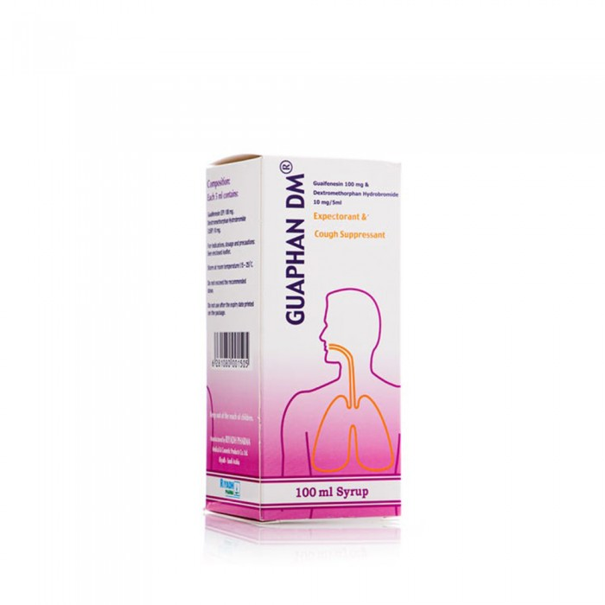
Guavan DM syrup-100 ml
5.70 R.S
Indications for use of guavan DM:- Improves respiratory function- Works to reduce cough.- Gets rid of throat irritations.- Treatment of tracheal secretions.

Slide 2
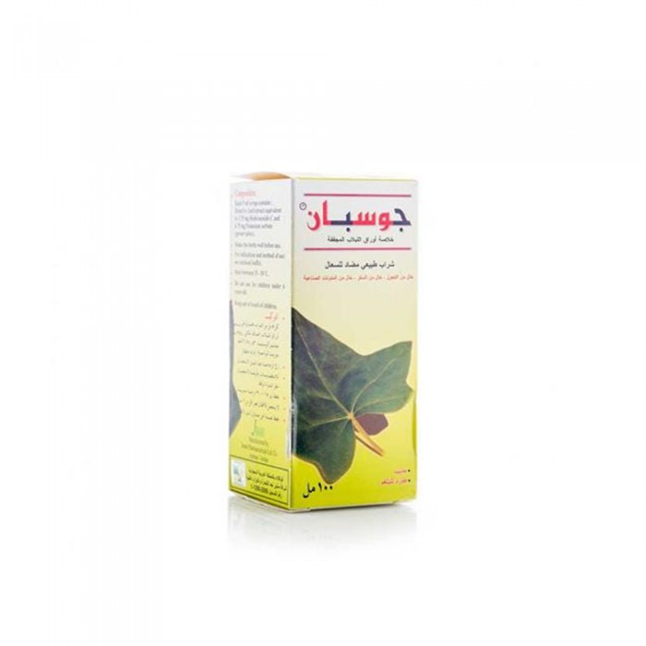
Jospin syrup 100 ml
39.75 R.S
- Cough syrup composed of ivy leaf extract that improves respiratory function and cleans the chest of mucus and fluid, safe and does not cause drowsiness

Slide 3
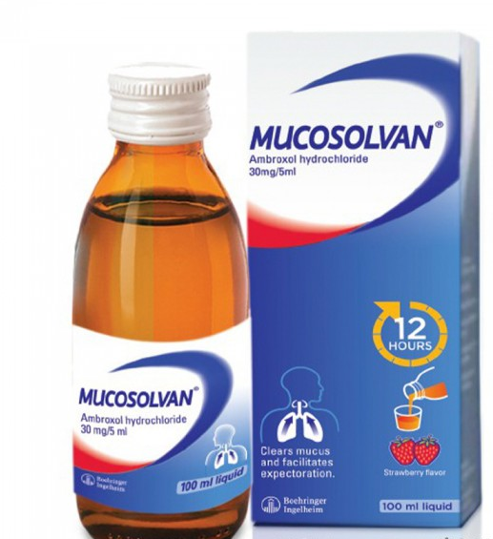
Mycosulfan syrup 100 ml
15.00 R.S
Micosulfan syrup containing ambroxol is an effective remedy used as an expectorant in cases of cough accompanied by phlegm and is used to dilute mucus when it is found in the respiratory tract and causes problems

Slide 4
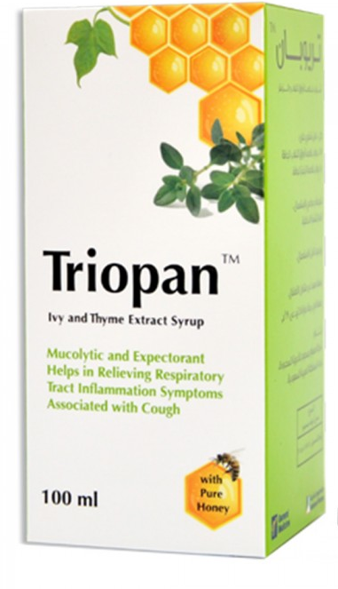
Triopane solvent, expectorant and cough Soothing Syrup 100 ml
39.65 R.S
Usage:- Adults: 7.5 ml 3 times daily .- Children from (10-6) years: 3 mL 3 times daily.- Children older than 10 years: 5 ml 3 times daily.

Slide 5
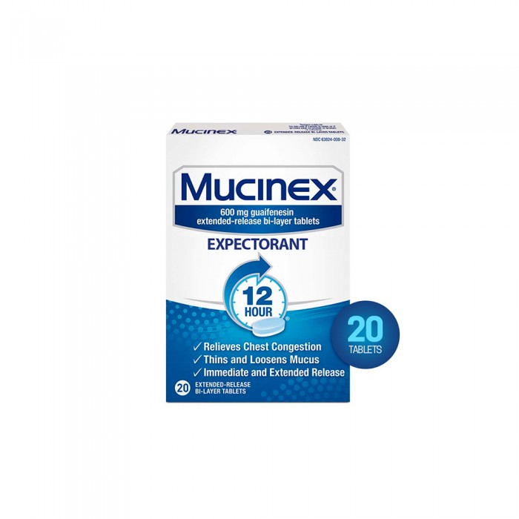
Myosinex 600 mg 20 tablets
28.85 R.S
Warnings and precautions:- It should not be used for children under 12 years old.- Please consult your doctor or pharmacist before taking it for pregnant or breastfeeding.- Keep out of reach of children.

